Slide 1
Final Presentation
PerlSquad

Slide 2
Project Requirement
Overview:
Two of our clients, Sarah & Emma, are making a board game for their students meant to help them learn and understand how biomes work.
Dr. Dani & Dr. Gibbs reached out to Dr. Liu and by extension, our team, to work on a computer game version to go alongside it.

Slide 3
Design
The goal is to build a fully functioning Biome Game. The game is designed for college students studying to teach middle school-aged and younger kids.
Some of those college students might also take the game and use it in their classroom.

Slide 4
Design (Cont.)
It is intended to promote education through gaming, while providing a fun-filled, competitive and interactive experience.

Slide 5
Design - Purpose Concept Map
Rectangles = concepts,
Ovals = purposes

Slide 6
Development Process - Meeting with Clients
We met with our clients three times throughout the semester - twice through google hangouts and once in person - to discuss game concepts.
We also corresponded for a while over GroupMe
Between the meetings and the GroupMe, the clients provided us with a few materials to give us a starting point.

Slide 7
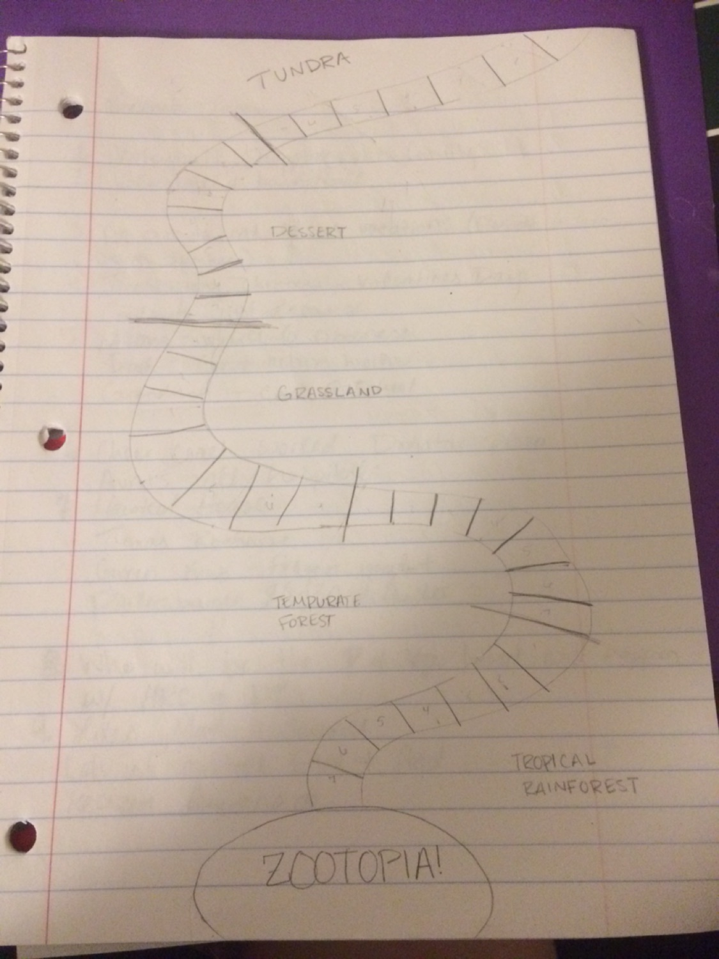
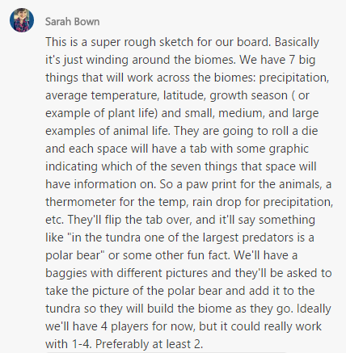
Development Process - Start

Slide 8
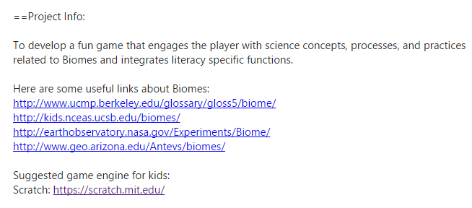
Development Process - Start (Cont)

Slide 9
Development Process - Meeting as a Team
It was soon apparent that the clients were very flexible with how the game could be designed, so taking some of the ideas they had shared with us, we set out to come up with our own concept.

Slide 10
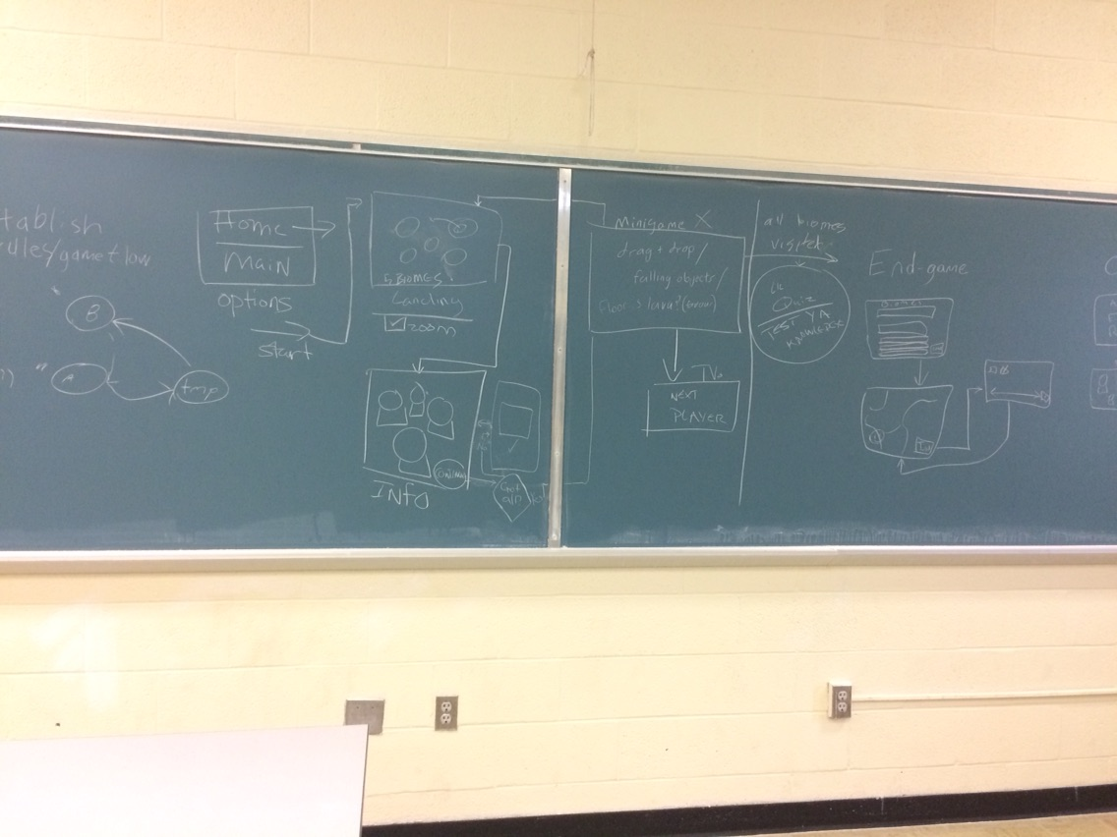
Development Process (Story-boarding)

Slide 11
Development Process - Improved Storyboarding
https://drive.google.com/open?id=0B2C38XSkD5aGdEdxa081c2F4eG8

Slide 12
Development Process - Divide and Conquer
Once a storyboard was developed, we divided up some of the tasks and attempted to tackle the game in parts.
In the end, we weren’t able to accomplish everything we wanted, but we were able to get something out of it.

Slide 13
Technology Stack and Architecture
EaselJS - Used to create simple graphics like lines and boxes for an HTML5 canvas. PreloadJS - Would be used to manage and co-ordinate the loading of assets. Gimp/Photoshop - Used to crop/scale image assets for game.

Slide 14
Technology Stack and Architecture
Entire system architecture: The game can be run on an HTTP web server or locally. Once the game starts running, the user will have the option to edit the game objects. Once the user hits “Start”, the game will retrieve the images/item descriptions from their respective files and start the game. A frontend website could potentially be added in the future to host the game as well, but for now, it will just run locally.

Slide 15
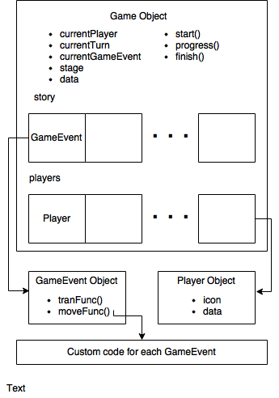
Technology Stack and Architecture
This image is a simplified model of the game engine architecture. Starting from the top, we see that the Game object provides what is intuitively a context for what is happening at any point in the game. It provides members and functions to retrieve information such as the current turn, active player, game progress and more.

Slide 16
Technology Stack and Architecture
It also provides functions to manipulate the context of the game, such as those used to move a player forward or go to the next turn. Although Javascript is a prototyped language, meaning new members and functions can be added to the Game object at runtime to add additional details about the game’s context, it still offers the data object as a generic container for more game information.

Slide 17
Technology Stack and Architecture
The Game object also maintains an array of Player objects proportional to the amount of students playing. References to specific players may be retrieved such that the player’s score or other information may be associated with them at runtime. Furthermore, if the player is graphically represented in the game, a reference to their EaselJS Shape object is available for manipulation.

Slide 18
Technology Stack and Architecture
Most importantly, the Game object maintains a list of GameEvent objects. It is through this that the game engine provides facilities for a deterministic linear story game. Each GameEvent has two members, tranFunc() and actionFunc(). The game engine starts with the first GameEvent in the array, executes its two members functions and moves onto the next GameEvent until there are no more.

Slide 19
Technology Stack and Architecture
At which point, Game.finish() is called to wrap up any loose ends. Game.start() is also available to put any code that needs to be executed before the first GameEvent. The tranFunc() and actionFunc() members of each GameEvent point to custom code that constitutes the actual story of the game. The tranFunc() member usually contains code that segues from one portion of the game to another, whether that be in a graphical or loading sense.

Slide 20
Technology Stack and Architecture
The actionFunc() member contains what actually happens, including functions for handling user input, rendering the UI, and anything else.

Slide 21

Implementation
To code new portions of the game, we created objects in their own file containing everything needed to facilitate that portion of the game. If data needs to be saved for a later GameEvent, it was stored in game.data. It is assumed a Game object named “game” is in scope at the time of execution. Then, we added a GameEvent object to the Game object by adding code to it’s loadStory() method.

Slide 22
Implementation
Given the shorter time period, we were able to create a single-player game in which the player went to a biome, learned a little about the animals, plant-life, growing season, precipitation, and latitude before playing a short, scored mini-game.

Slide 23
Individual Contributions - Alex Mayle
Set up game engine/architecture
Integrated other team member’s components into the existing setup

Slide 24
Individual Contributions - Brian Reynolds
Created the start menu, including options to expand on multiplayer in the future.
Created the scavenger hunt menu and item info screens
Properly set up comments and generated documentation
Developed an options menu for later implementation

Slide 25
Individual Contributions - Eric Keep
Designed a mini-game with a built-in scoring system
Developed a drag-and-drop module for later implementation

Slide 26
Individual Contributions - Favour Ogundare
Built game image library
Developed a pre-loading module for later implementation

Slide 27
Individual Contributions - Robert Smith
Helped build game image library
Found and tested demo platform
Developed scrolling environment module for future implementation

Slide 28
Links
Github: https://github.com/Sagerune/PerlSquad
CreateJS: http://www.createjs.com/ EaselJS: http://www.createjs.com/easeljs
PreloadJS: http://www.createjs.com/preloadjs Photoshop: http://www.adobe.com/photoshop Gimp: https://www.gimp.org/

Slide 29
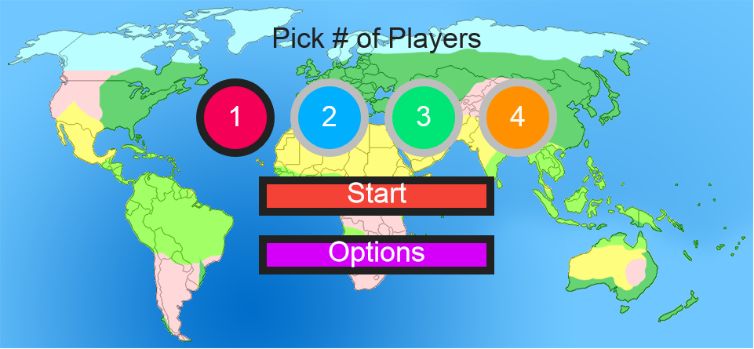
Screenshots

Slide 30
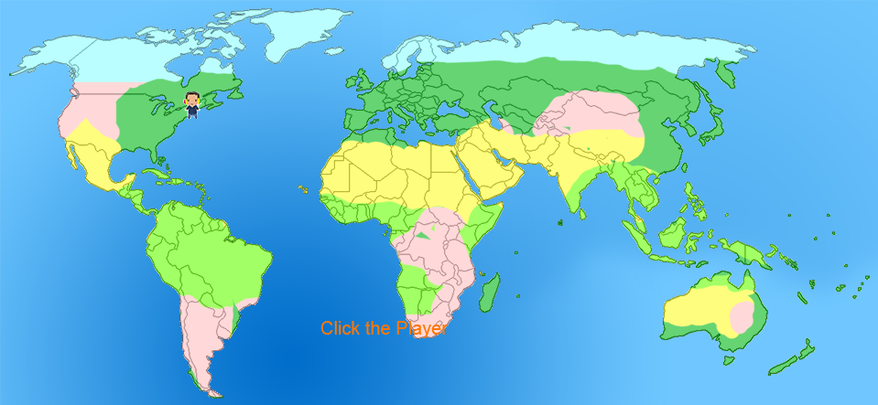
Screenshots

Slide 31
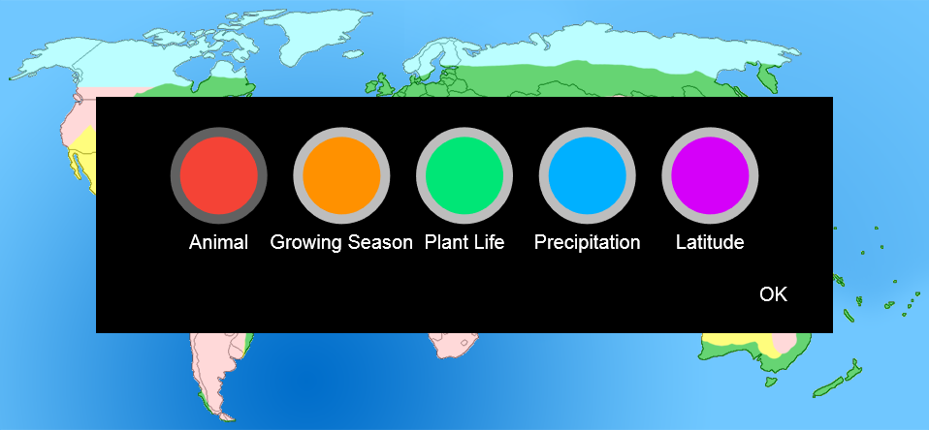
Screenshots

Slide 32
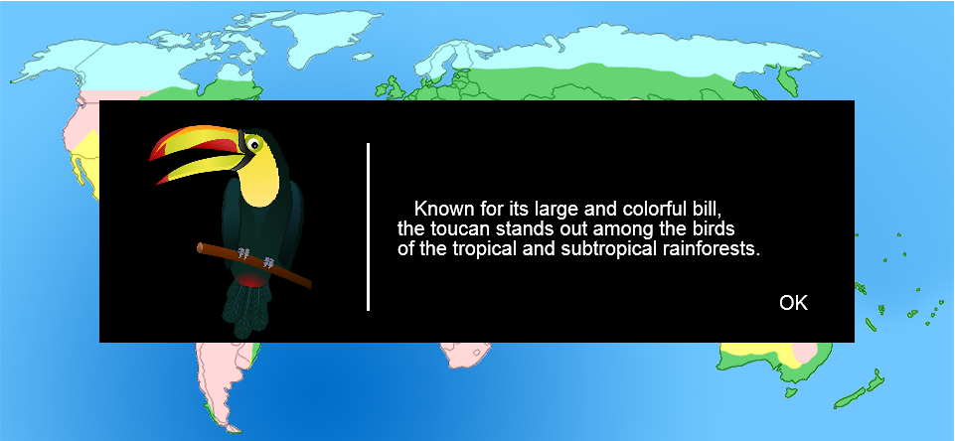
Screenshots

Slide 33
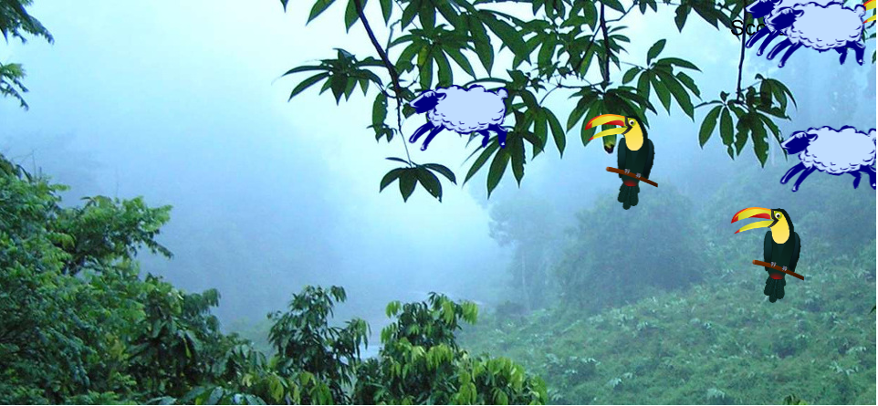
Screenshots

Slide 34
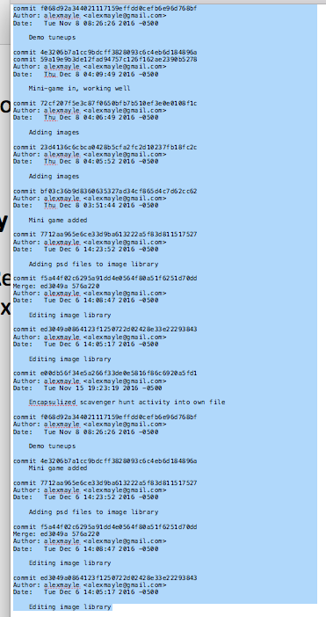
Commit Logs - Alex Mayle

Slide 35
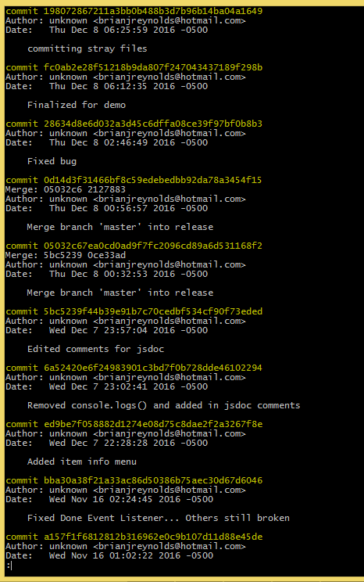
Commit Logs - Brian Reynolds

Slide 36
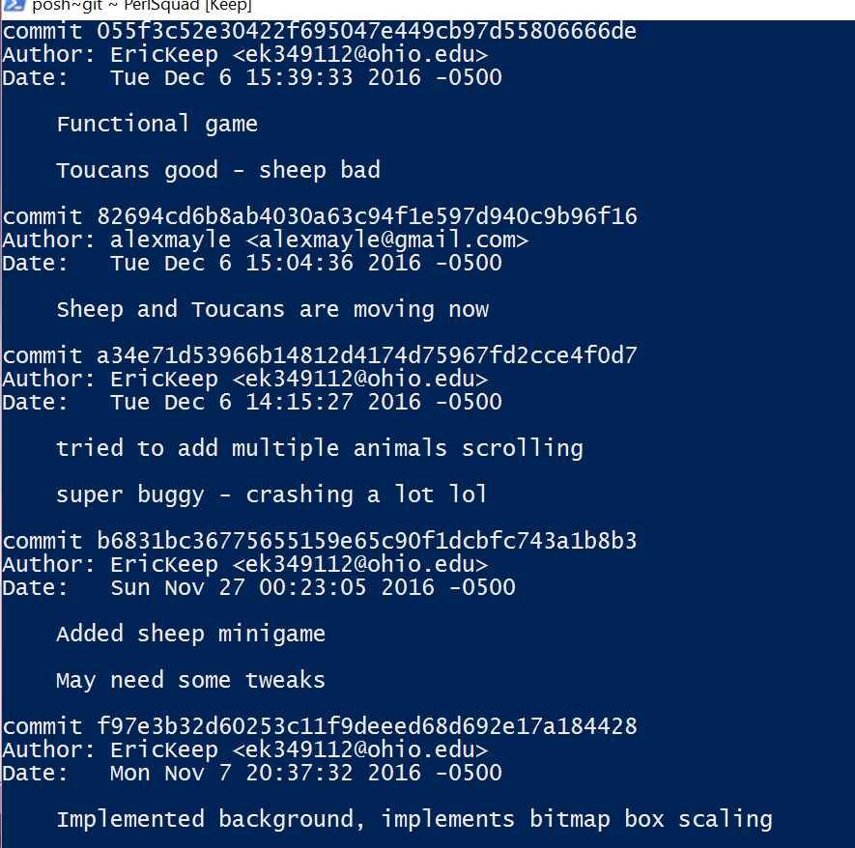
Commit Logs - Eric Keep

Slide 37
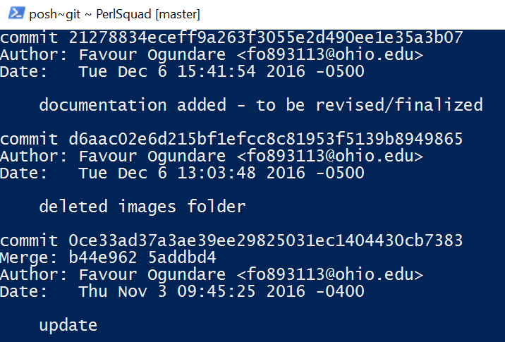
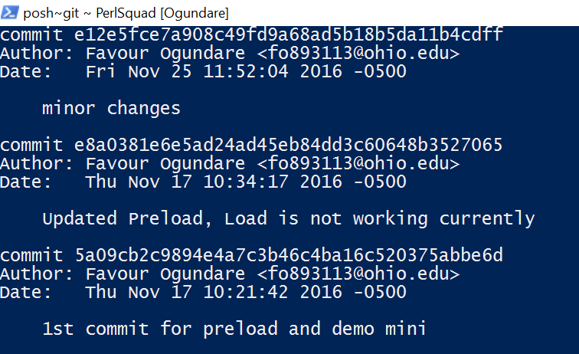
Commit Logs - Favour Ogundare

Slide 38
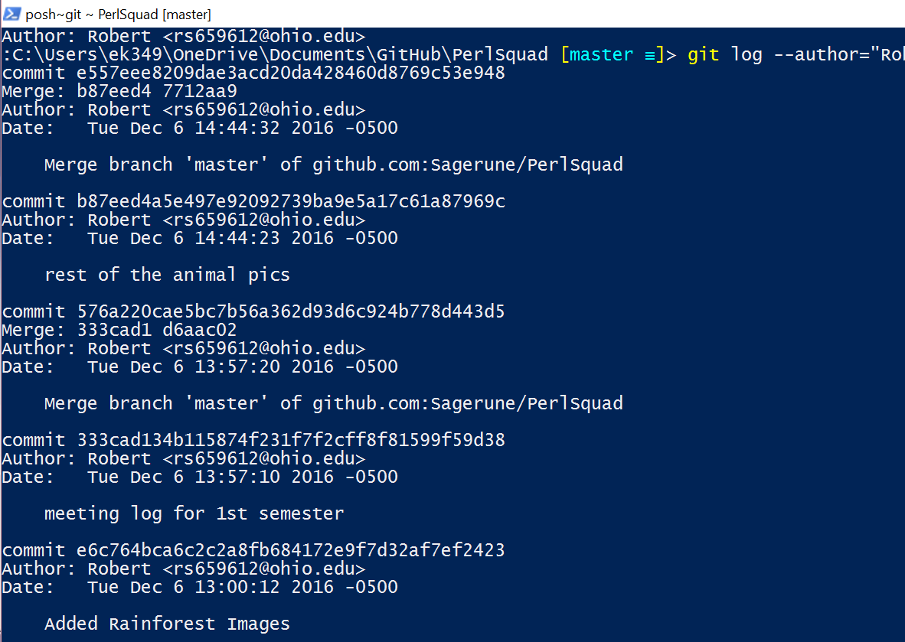
Commit Logs - Robert Smith

